Slide 1
Wireless network and IoT security
Lecture 10: Wi-Fi Protected Access (WPA)
Instructor: Kui Ren

Slide 2
Wi-Fi Protected Access (WPA)
Wi-Fi Protected Access (WPA) is
A response by the WLAN industry to offer an immediate, a stronger security solution than WEP.
WPA is intended to be:
A software/firmware upgrade to existing access points
Inexpensive in terms of time and cost to implement
Compatible with vendors
Suitable for enterprise, small sites, home networks

Slide 3
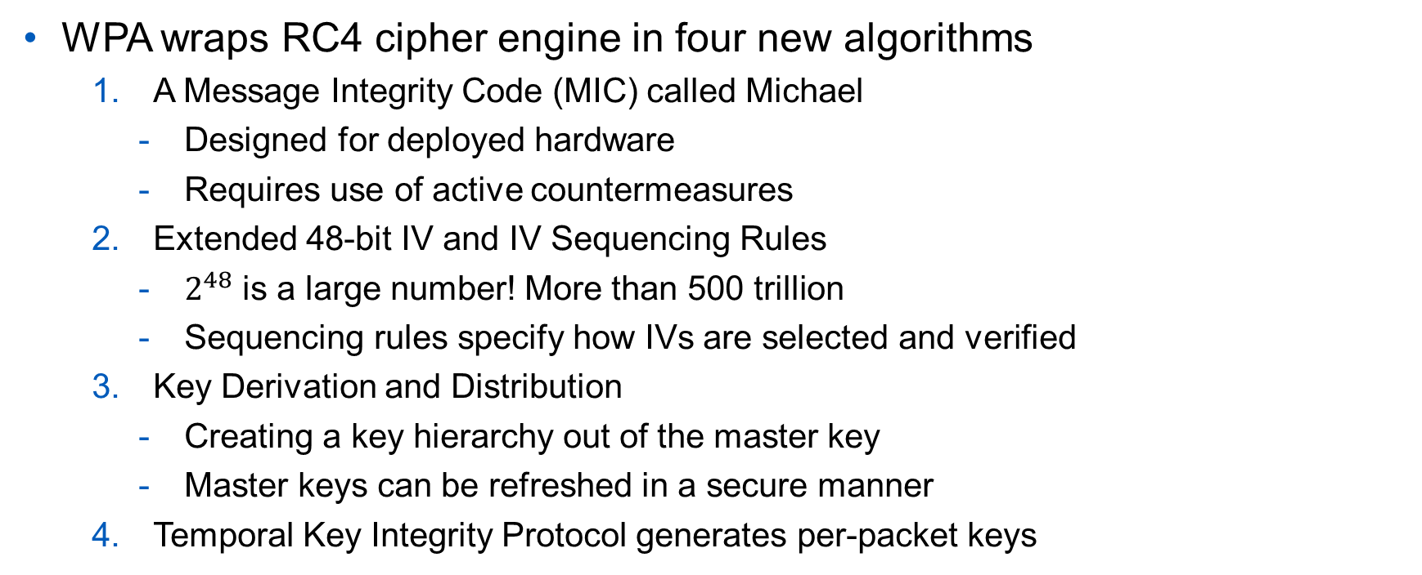
How WPA Addresses the WEP Vulnerabilities
WPA wraps RC4 cipher engine in four new algorithms
A Message Integrity Code (MIC) called Michael
Designed for deployed hardware
Requires use of active countermeasures
Extended 48-bit IV and IV Sequencing Rules
$2^{48}$ is a large number! More than 500 trillion
Sequencing rules specify how IVs are selected and verified
Key Derivation and Distribution
Creating a key hierarchy out of the master key
Master keys can be refreshed in a secure manner
Temporal Key Integrity Protocol generates per-packet keys

Slide 4
Key WPA Facts
Encryption method: RC4
Key size: 128 bits (varies)
Changes encryption key every frame
Key management: TKIP
Resolves keys to be used, looks at client’s configuration;
Sets unique default key for each client
Hash method: Michael
8 bytes, placed between data and ICV
802.1x authentication: can be required

Slide 5
Message Integrity Check: Michael Algorithm
Message Integrity Code (MIC) - 64-bit message calculated using the “Michael” algorithm
Designed for deployed legacy hardware
The Michael algorithm was the strongest that WPA designers could come up with that would still work with most older network cards
Uses a lot swaps, shifts, even discarding operations
Protects both data and header
The MIC is a hash that is calculated on a per-packet basis
The MIC is also on a per-sender, per-receiver basis
The MIC is based on seed value (IVs), destination MAC, source MAC, and payload

Slide 6
Data Integrity: The Michael MIC Algorithm
Destination MAC
Source MAC
802.11 Data Payload
Michael
64 Bit MIC
16 Bit IV
Data Payload
64 Bit
MIC
32 Bit
ICV
Per Frame
Encryption
Frame Transmitted

Slide 7

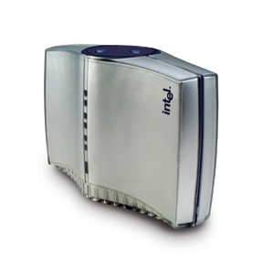
Defeating Replays: IV Sequence Enforcement
Due to inevitable weaknesses of Michael, WPA implements a 16-bit monotonically incrementing counter that discourages replay attacks:
Take the 1st and 3rd bytes of the old IV
Reset packet sequence # to 0 on rekey
Increment sequence # by 1 on each packet
Drop any packet received out of sequence
Hdr
Packet n
Hdr
Packet n + 1
Wireless Station
Access Point
Hdr
Packet n

Slide 8
TKIP Re-Key Mechanism
Refers to a process of delivering fresh encryption and integrity keys (MIC Keys) to the stations and Aps.
WPA Key hierarchy consists of a master key and session keys
Master key, called the Pairwise Master Key (PMK), is derived from either an 802.1X key exchange or from the passphrase
Session keys, collectively called the Pairwise Transient Key (PTK), are derived from the master key

Slide 9
Pairwise Master Key (PMK) Construction
Passphrase
SSID
SSID Length
Number of iteration: 4096
Length of the result key: 256
(Password-Based Key Derivation Function 2 (PBKDF2)
Pairwise Master Key (PMK)

Slide 10
Pairwise Transient Key (PTK) Construction
PMK
ANonce
SNonce
STA MAC Address
AP MAC Address
HASH
Pairwise Transient Key (PTK)

Slide 11
TKIP: Per-Packet Key Mixing
WEP constructs a per-packet key by simply concatenating a base-key and the IV
TKIP constructs a per-packet key by going through 2 key mixing phases
The mixing phases make difficult for an attacker to correlate IVs and per-packet key
Temporal Key
Phase 1
Intermediate Key
MAC Addr
Phase 2
Per-packet key
Sequence Number

Slide 12
TKIP Encryption Process

Slide 13
TKIP Decryption Process

Slide 14
TKIP Summary
TKIP appears to provide weak but genuine security
External review by Ron Rivest, David Wagner, John Kelsey, Susan Langford, and others
TKIP meets goal of software deployment on almost all existing equipment
Does not appear to significantly degrade performance over WEP
Meets market’s requirement for a migration path based on pre-existing installed base

Slide 15
How to Negotiate a Passphrase and PTK?
Pre-Shared Key Mode
No RADIUS server required
“Shared Secret” is used for authentication to access point
Management is handled on the AP
Vulnerable to dictionary attacks
Enterprise Mode
Requires an authentication server
Uses RADIUS protocols for authentication and key distribution
Centralizes management of user credentials

Slide 16
WPA-PSK Overview
For home / SOHO use
Significantly increases the effort required to allow passive monitoring and decrypting of traffic
Adopts 4-Way Handshake Authentication
Also generates the secret session keys (PTK)
Pre-shared Key + TKIP
No standardized way of changing shared secret
If shared secret becomes known, network security may be compromised
Weak against passive dictionary attack
The more complex the shared secret, the less likely it will fall to dictionary attacks

Slide 17
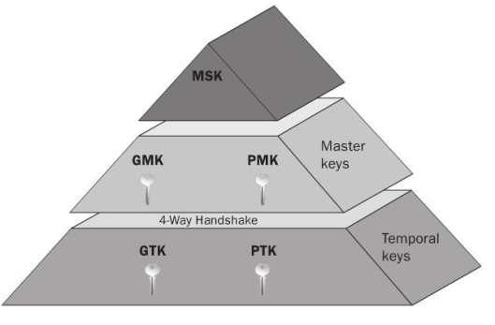
The Role of 4-Way Handshake: Authentication and Key Exchange

Slide 18
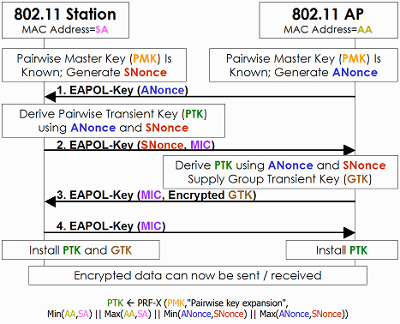
PSK: 4-Way Handshake Authentication

Slide 19
Vulnerabilities of 4-way handshake
4-way handshake protected with PTK
The strenght of PTK relies on the strength of the password
PSK = PBKDF2 (Password, SSID, SSIDlength, 4096, 256)
Offline brute-force and dictionary attacks possible
Attacker captures (records) 4-way handshake messages
Attacker performs brute-force or dictionary attacks (at home)

Slide 20
WPA-PSK: the Brute Force Attack
How much time it will take to crack a simple passphrase with only alphanumerical values (upper and lower case)
Smallest WPA passphrase: 8 characters (max 63)
62 possibilities per character: [A-Z][a-z][0-9]
62^8 = 218 340 105 584 896 possible keys
Using a 280GTX processor (11000 keys/sec)
218340105584896/11000k/s= 19 849 100 508 sec
19849100508 sec = 5 513 639 hours
5513639 hours = 229 735 days
229735 days = 630 years

Slide 21

630 Years for an 8 Character Key
A bit too long for a simple passphrase
For a 12 character long passphrase, brute force will take 9 309 091 680 years.
Dictionary attack is still the better solution.
The better solution

Slide 22
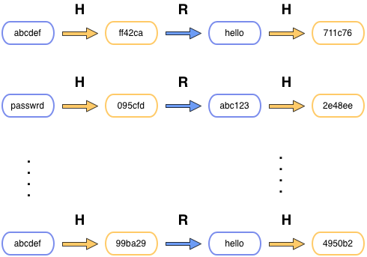
WPA-PSK: Rainbow Table
Rainbow tables are indexed hash lists
Pre-hash millions of words against top SSID's
Required 2-3 TB of space
Known tables exist for up to 14 characters
Cracks WPA v1 and v2 with pre-shared key
Drastically faster checking onsite

Slide 23
Suggestions for WPA-PSK
WPA-PSK should be used with care
Vulnerable to external dictionary attacks, if short
Choose WPA + 802.1X
No effective attacks found so far

Slide 24
WPA Enterprise Mode
Authentication server distributes different keys to each user using 802.1X.
Provide enhanced security and authentication
Preferred for enterprise mode - business, government, education
Notes:
Provide enhanced security and authentication
Preferred for enterprise mode - business, government, education

Slide 25
IEEE 802.1X
802.1X is an IEEE standard for port-based network access control for LANs
It fulfills the security loopholes of access control, authentication and key management in the 802.11 architecture
The authentication is usually done by a third-party entity, such as a RADIUS (Remote Authentication Dial In User Service) server
Notes:
Remote Authentication Dial In User Service (RADIUS) is a networking protocol that provides centralized Authentication, Authorization, and Accounting (AAA) management for computers to connect and use a network service. RADIUS was developed by Livingston Enterprises, Inc.,

Slide 26
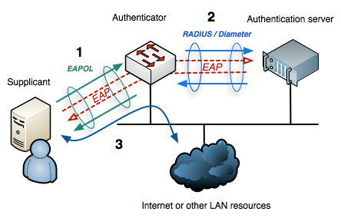
Main 802.1X components
Supplicant (e.g., a wireless client)
Authenticator (e.g., an Access Point)
Authentication Server (e.g., a RADIUS server)

Slide 27
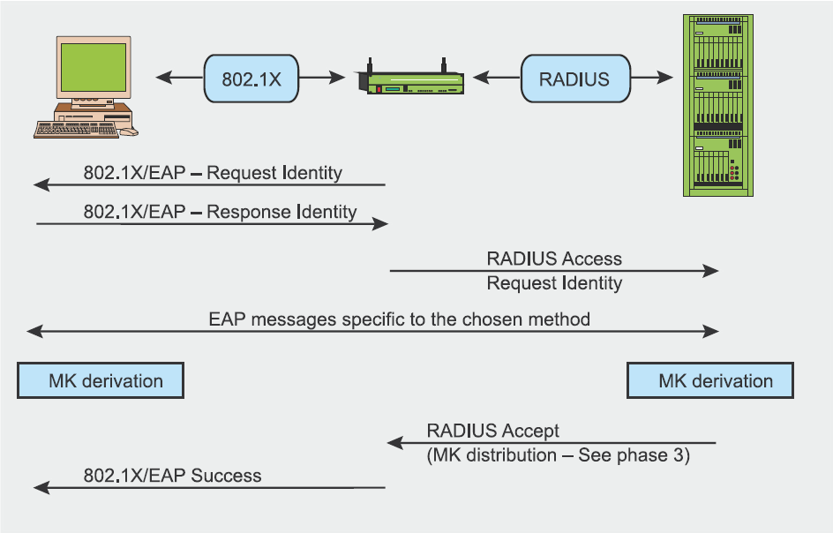
802.1X Authentication
Based on EAP (Extensible Authentication Protocol) and the specific authentication method agreed in the association phase.

Slide 28
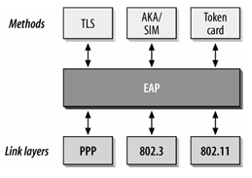
Extensible Authentication Protocol (EAP)
A carrier protocol designed to transport the messages of “real” authentication protocols (e.g., TLS)
It is a generic (flexible) authentication protocol that can run over any link layer protocol
It Provides some common functions and a negotiation of the desired authentication mechanism called methods.

Slide 29
Extensible Authentication Protocol (EAP)
EAP is very simple, only four types of messages:
EAP request – carries messages from AS to M
EAP response – carries messages from M to the AS
EAP success – signals successful authentication
EAP failure – signals authentication failure
Authenticator (AP) doesn’t understand what is inside the EAP messages, it recognizes only EAP success and failure
EAP is not an authentication method itself

Slide 30
Extensible Authentication Protocol (EAP)
End-to-end transport between client and authentication server
AP proxies EAP between 802.1X and backend protocol between AP and AS (e.g. RADIUS)
within the scope of IEEE 802.11i
EAP-TLS
EAP
EAPoL (802.1X)
EAP over RADIUS
802.11
RADIUS
TCP/IP
802.3 ili drugi
Mobile client
Access point
Authentication server

Slide 31
Extensible Authentication Protocol (EAP)
EAPoL (EAP over LAN) [802.1X]
Encapsulate EAP messages into LAN protocols (e.g., Ethernet)
Used to carry EAP messages between the client and the AP
RADIUS (Remote Access Dial-In User Service)
Used to carry EAP messages between the AP and the authentication server
EAP-TLS
EAP
EAPoL (802.1X)
EAP over RADIUS
802.11
RADIUS
TCP/IP
802.3 ili drugi
Mobile client
Access point
Authentication server

Slide 32
EAP in Action
Client
encapsulated in EAPOL
AP
Auth server
EAPOL-Start
EAP Request (Identity)
encapsulated in RADIUS
EAP Response (Identity)
EAP Response (Identity)
EAP Request 1
EAP Request 1
EAP Response 1
EAP Response 1
embedded auth. protocol
...
...
EAP Request n
EAP Request n
EAP Response n
EAP Response n
EAP Success
EAP Success

Slide 33
IEEE 802.1X authentication summary
At the end of authentication:
The authentication server and client have established a session
The authentication server and client possess a mutually authenticated Master Key (derived from the concrete EAP method)
Master Key represents decision to grant access based on authentication
Client and authentication server have derived PMK (Pairwise Master Key)
PMK is an authorization token to enforce access control decision at AP
Authentication server has distributed PMK to an AP

Slide 34
The Need for A Better (Long Term) Security Standard
Still, TKIP is not a favorable solution due to the weakness of RC4
Beck-Tews attack
Active attack based on chopchop method for recovering plaintext
Requires support for alternative QoS channels to by-pass anti-replay protection
Rate-limited since correctness of plaintext guess is indicated by MIC verification failure, and only 2 failures per minute are tolerated

Slide 35
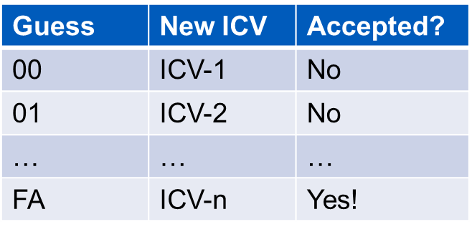
The Beck-Tews attack: Chopchop Method
Encrypted Data
ENC. ICV
FA
Encrypted Data
?
Guess the value of the deleted byte and calculate new ICV

Slide 36
The Beck-Tews attack
Normally, in WPA, a falsified encrypted packet that is made from an encrypted packet accepted in the past is discarded since the value of IV is checked.
However, the chopchop attack can be executed on WPA implementations those support IEEE802.11e QoS features, which allow 8 different channels for different data flows, and each channel has the TSC counter independently.
The attacker can capture an encrypted packet from one channel and execute the chopchop attack on another channel that has a smaller TSC counter.

